Slide 1
Creational Patterns
Design patterns

Slide 2
Creational Pattern
Singleton
Factory
Prototype
Abstract Factory
Builder

Slide 3
SINGLETON
The one and only

Slide 4
Why Singleton?
When you only need only one instance of the class

Slide 5
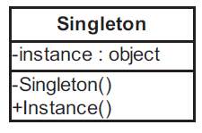
Singleton class diagram
Hide the constructor
Only create the instance at the first time of accessing the instance

Slide 6
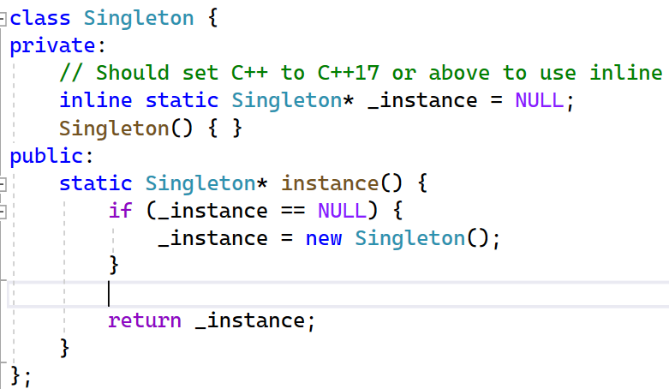
C++ Proof of concept code

Slide 7
C++ smart pointer improvement
shared_ptr
make_shared

Slide 8
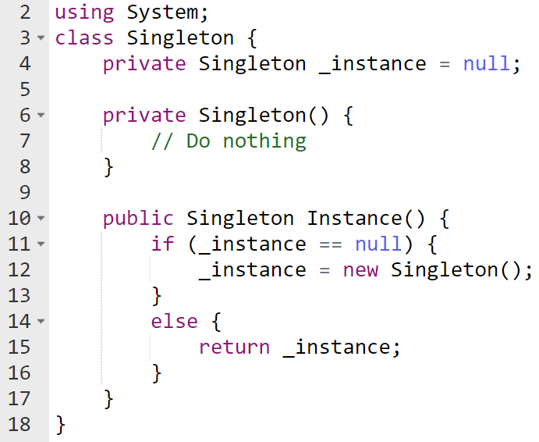
C# Proof of concept code

Slide 9
Example
Write a SingletonCounter class
Display the data inside this class

Slide 10
FACTORY
The creator

Slide 11
Why Factory?
Based on the choice of the user, the Factory class create the respective product

Slide 12
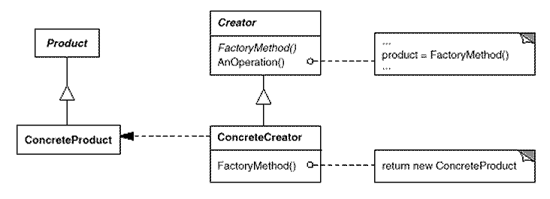
Factory core concept

Slide 13
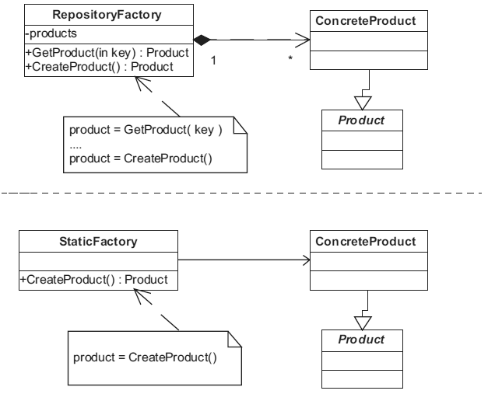
Two ways of implementing
[Christopher G. Lasater (2007). Design Patterns, Wordware Publishing, Inc.]

Slide 14
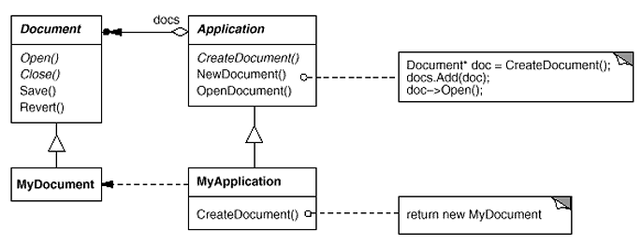
Factory in context
[Erich Gamma, Richard Helm, Ralph Johnson, John Vlissides (1995). Design Patterns - Elements of Reusable Object-Oriented Software, Addison-Wesley]

Slide 15
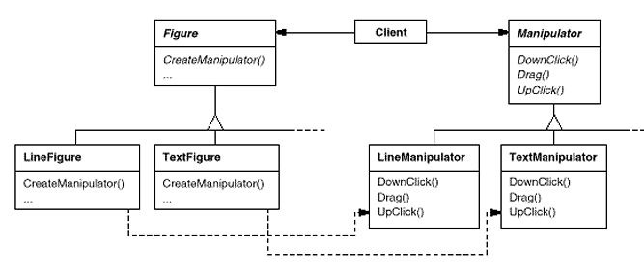
Factory common usage
[Erich Gamma, Richard Helm, Ralph Johnson, John Vlissides (1995). Design Patterns - Elements of Reusable Object-Oriented Software, Addison-Wesley]

Slide 16
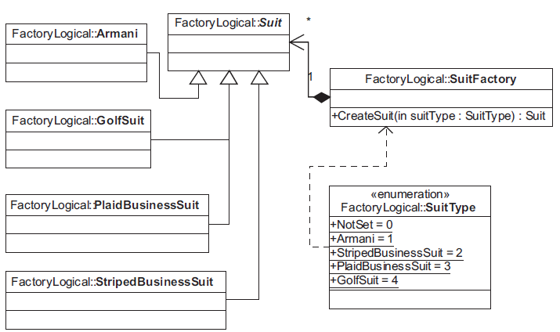
Factory basic implementation
[Christopher G. Lasater (2007). Design Patterns, Wordware Publishing, Inc.]

Slide 17
Example 01
Read back the list of graphic objects from text file
Point (3, 7)
Line ( (x1, y1), (x2, y2) )
Point (3, 7)
Rectangle ( (x1, y1), (x2, y2))
Ellipse ((x1, y1), (x2, y2))

Slide 18
Example 02
Read back the list of employees from text file
DailyEmployee: John Walker
DailyPayment=100$; TotalDays=28
HourlyEmployee: Rachyl Napier
HourlyPayment=15$; TotalHours=1200
ProductEmployee: Romaine Donna
PaymentPerProduct=10$; TotalProducts=180
Manager: Clarinda Hyram
FixedPayment=500$; TotalEmployees=5; PaymentPerEmployee=100$

Slide 19
PROTOTYPE
The preview

Slide 20
Why prototype?
Propose the user with all possible choices
Then clone the choice

Slide 21
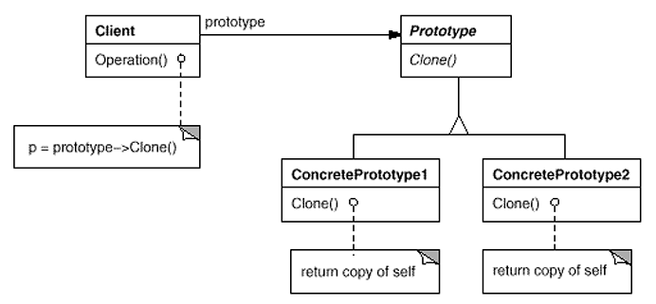
Prototype
[Erich Gamma, Richard Helm, Ralph Johnson, John Vlissides (1995). Design Patterns - Elements of Reusable Object-Oriented Software, Addison-Wesley]

Slide 22
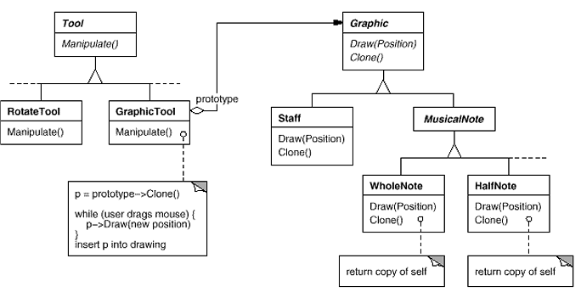
Prototype

Slide 23
Examples
Improve the factory patterns for
Reading graphic objects
Reading employees

Slide 24
BUILDER
The waiter

Slide 25
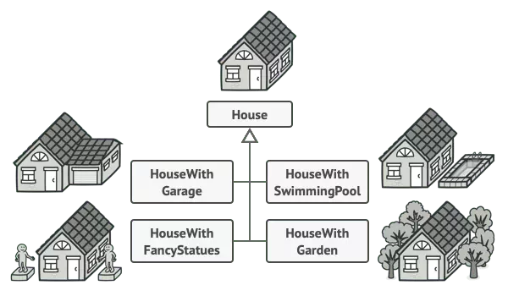
Why builder?
When we want to create an object composed of multiple parts

Slide 26
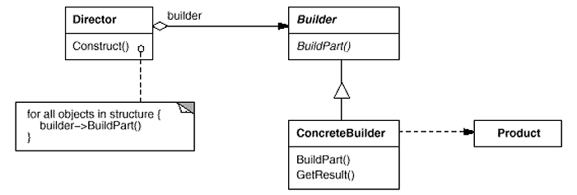
Builder concept
[Erich Gamma, Richard Helm, Ralph Johnson, John Vlissides (1995). Design Patterns - Elements of Reusable Object-Oriented Software, Addison-Wesley]

Slide 27
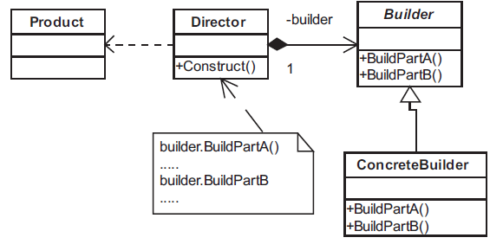
Builder
[Christopher G. Lasater (2007). Design Patterns, Wordware Publishing, Inc.]

Slide 28
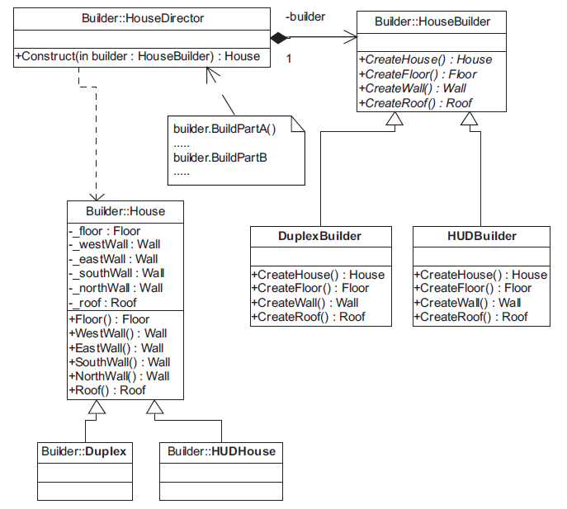
Mẫu Builder
[Christopher G. Lasater (2007). Design Patterns, Wordware Publishing, Inc.]

Slide 29
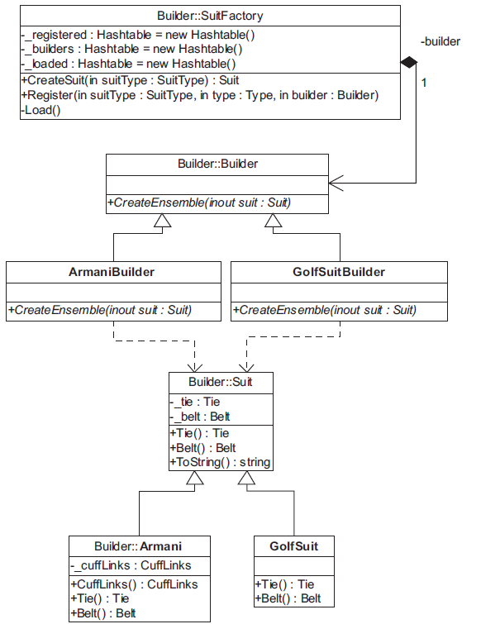
Mẫu Builder
[Christopher G. Lasater (2007). Design Patterns, Wordware Publishing, Inc.]

Slide 30
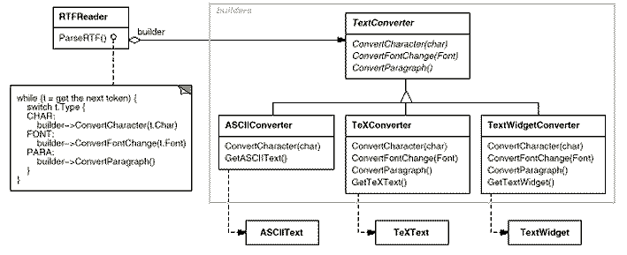
Builder
[Erich Gamma, Richard Helm, Ralph Johnson, John Vlissides (1995). Design Patterns - Elements of Reusable Object-Oriented Software, Addison-Wesley]

Slide 31
ABSTRACT FACTORY
The collector

Slide 32
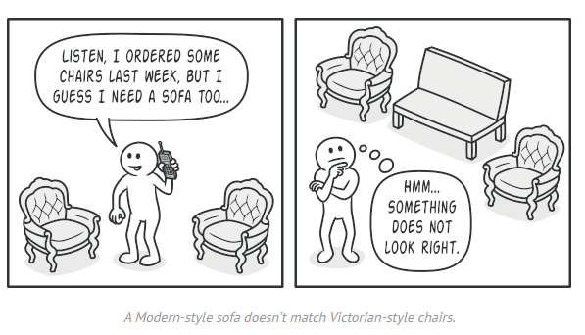
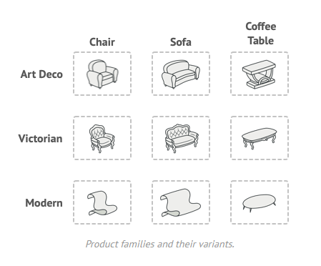
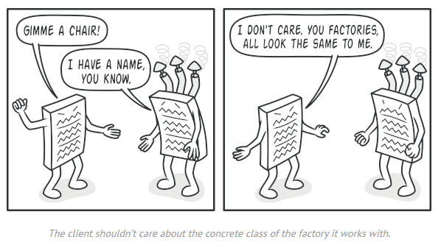
Abstract factory story
refactoring.guru

Slide 33
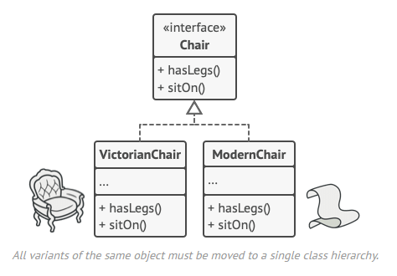
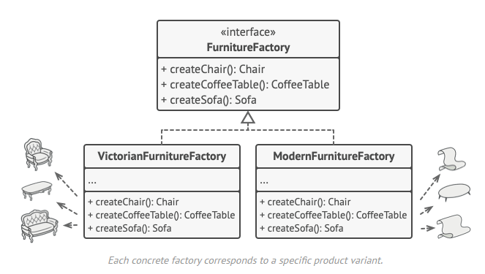
Solution

Slide 34
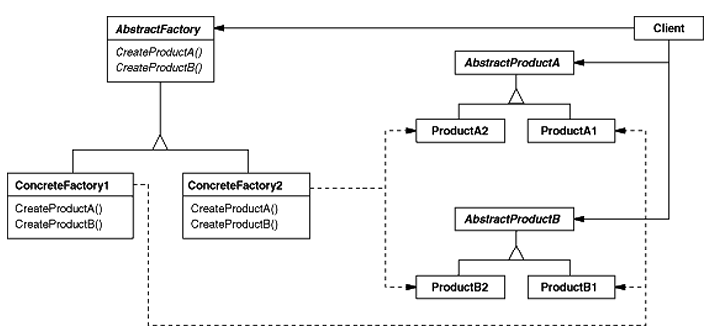
Abstract Factory
[Erich Gamma, Richard Helm, Ralph Johnson, John Vlissides (1995). Design Patterns - Elements of Reusable Object-Oriented Software, Addison-Wesley]

Slide 35
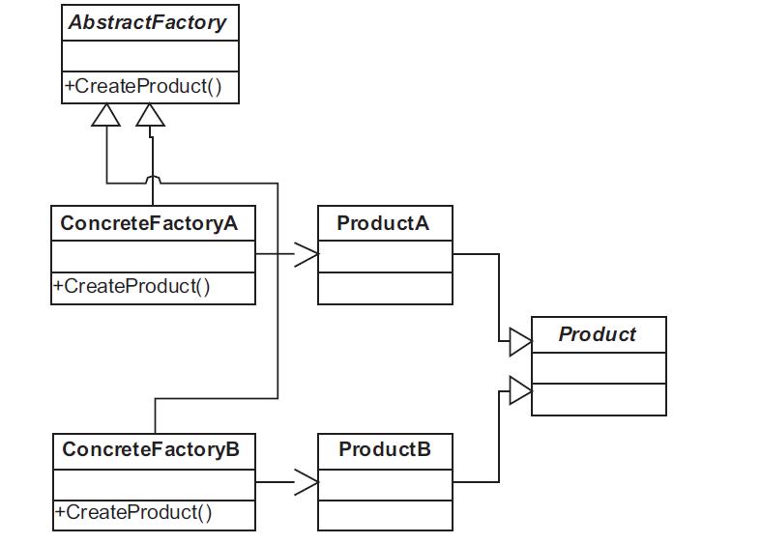
Abstract Factory
[Christopher G. Lasater (2007). Design Patterns, Wordware Publishing, Inc.]

Slide 36
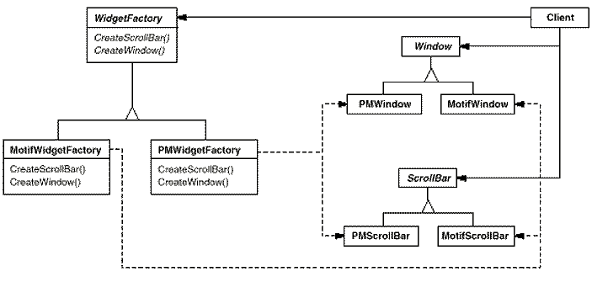
Abstract Factory
[Erich Gamma, Richard Helm, Ralph Johnson, John Vlissides (1995). Design Patterns - Elements of Reusable Object-Oriented Software, Addison-Wesley]

Slide 37
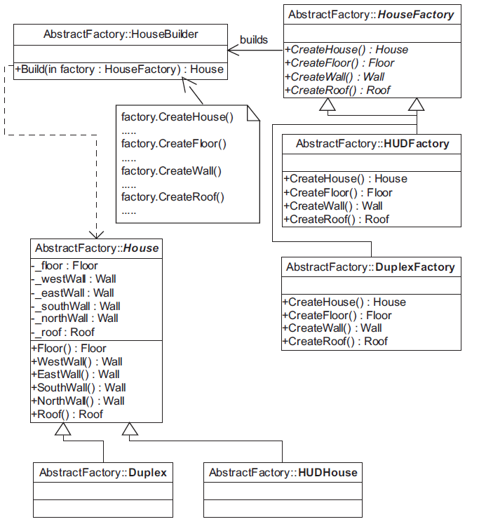
Abstract Factory

Slide 38
Exercise
The school trains students major in 4 bulks: A, B, C, D
A: Mathematics, Physics, Chemistry
B: Mathematics, Chemistry, Biology
C: Literature, History, Geography
D: Mathematics, Literature, ForeignLanguage (English / French / Chinese / Japanese)
Each subject will have a teacher who can teach that subject :D
Suppose you have made the configuration for all of the bulks, print out the available bulks for the students

Slide 39
For example
A: Mathematics (Mr Luong), Physics (Mr Thanh), Chemistry (Ms Hong)
A: Mathematics (Mr Tan), Physics (Mrs Nhung), Chemistry (Ms Le)
B: Mathematics (Ms Diem), Chemistry (Mr Hai), Biology (Mr Thai)
C: Literature (Ms Huong), History(Mr Tung), Geography(Mr Lam)
D: Mathematics (Ms Diem), Literature (Mr Hai), French (Mr Toan)
D: Mathematics (Ms Diem), Literature (Mr Hai), Japanese (Mr Long)

